Slide 1
Problems Related to Registers

Slide 2




Problem
Q . 1 The initial contents of the 4 bit serial in parallel O/P right shift register shown in the fig. is 0110. after three clock pulses are applied the contents of the shift register will be.

Slide 3




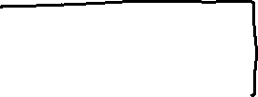
Q2. a 4 bit serial In Parallel out shift register is used within a feedback as shown in figure. The shifting sequence is
If this D4, D3 D2 and D1 having 0000 initially. The o/p repeats after.
(1). 4 clock cycle (2). 6 clock cycle (3). 15 clock cycle.

Slide 4
Computer Architecture
Computer architecture is the study of structural and logical view of computer system.
The study of computer architecture involves both Hardware and programming/ software requirements
( as seen by assembly language programming instruction set includes opcode, registers and Memory.)
Opcode :- programming
registers and memory:- Hardware
So we can say that the study of Architecture covers both instruction set architecture and Machine implementation organization( i.e. Cache, physical memory, pipelining, bus).

Slide 5
Von Neumann Architecture
Von –Neumann is a specific type of “computer Architecture”, in which instructions and data are stored together in a common memory.
This type of architecture is different from Harvard Architecture in which separate memories were used to store the instructions and data.
This type of computer( Von-Neumann) based on SISD. Which mean they execute a single sequence of instructions which operate on a single stream of data value.

Slide 6
Von Neumann Architecture
The von –Neumann computer concept was developed in 1940,after that nearly all computers are based on this stored program concept.
after the von-neumann the machine instructions and data (program data) are stored in computer memory in the same manner.
after this concept the computer industry began a rapid development with the speed and cost of computer system improving by the factor of two every two years.
it is slow due to sequential execution of instruction of program.

Slide 7
Key features of Von. Neumann Machine
1. The H/W of von-Neumann M/C consists of a CPU, which includes an ALU and CU.
2. A main memory system.
3. An input/output system.
4. The von- Neumann M/C use stored program concept.( both the program and data are stored in common memory)
Note:- computers prior this idea used to store the program and data separate memories.
5. Each location of the memory of Von –Neumann M/C can be addressed independently.
6. Execution of instruction in Von-Neumann machine is carried out in a sequential fashion.

Slide 8
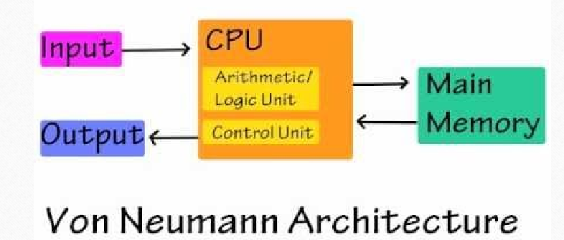
Von- Neumann Architecture

Slide 9
Thanks

